Slide 1
QSYS – Qualification and Commissioning Overview
Daniel Berkowitz (ATS/ACR)

Slide 2
QSYS – System Breakdown
Cryoplant & Infrastructure
WCS
QRB
WSH
WSH
WSH
WPS
Cryo Backbone
QLM
QVB
QVB
QVE
Cryomodules
QM
QM
QCELL

Slide 3
Definitions

Slide 4
Q or C 1. 1.x = standalone w/o CIS
Q or C 1.2.x = standalone w/ CIS
Q or C 2.2.x = integrated with X
Q or C 3.2.x = integrated with X + Y
…
Q&C Campaign
Q&C Campaign: Qualification and Commissioning
Qualification (Validation of Equipment & Systems)
Goal: Ensure the system meets predefined specifications.
Notes: Can be done at any point.
Aspects:
Design Qualification (DQ) – Confirms the design meets the required standards.
Installation Qualification (IQ) – Verifies proper installation (punching list)
E.g. leak test, presence of all equipment
Operational Qualification (OQ) – Ensures the system functions as intended.
Performance Qualification (PQ) – Confirms consistent performance under real conditions.
Commissioning (Readiness for Operation)
Goal: Systematic process of starting up and testing equipment and systems.
Notes: The system has been installed on its final place and won’t be moved anymore
Aspects:
Commissioning Warm & w/o process fluid – Testing without process fluid (e.g., dry runs, control system validation), can be virtual or with true sensors
Commissioning Warm & w/ process fluid – Testing with operational fluids.
Commissioning Cold & w/ process fluid – Testing with operational fluids.
Highlighted differences VS qualification
Installation at final location (not planned to move it again)
Automated controls ready for startup → supply the users
The qualification is to check the specs against measurements
You can commission a system that does not meet the specs
Typical steps that can be performed in both qualification and commissioning
Purging and conditioning
Calibration and zero, on site ?

Slide 5
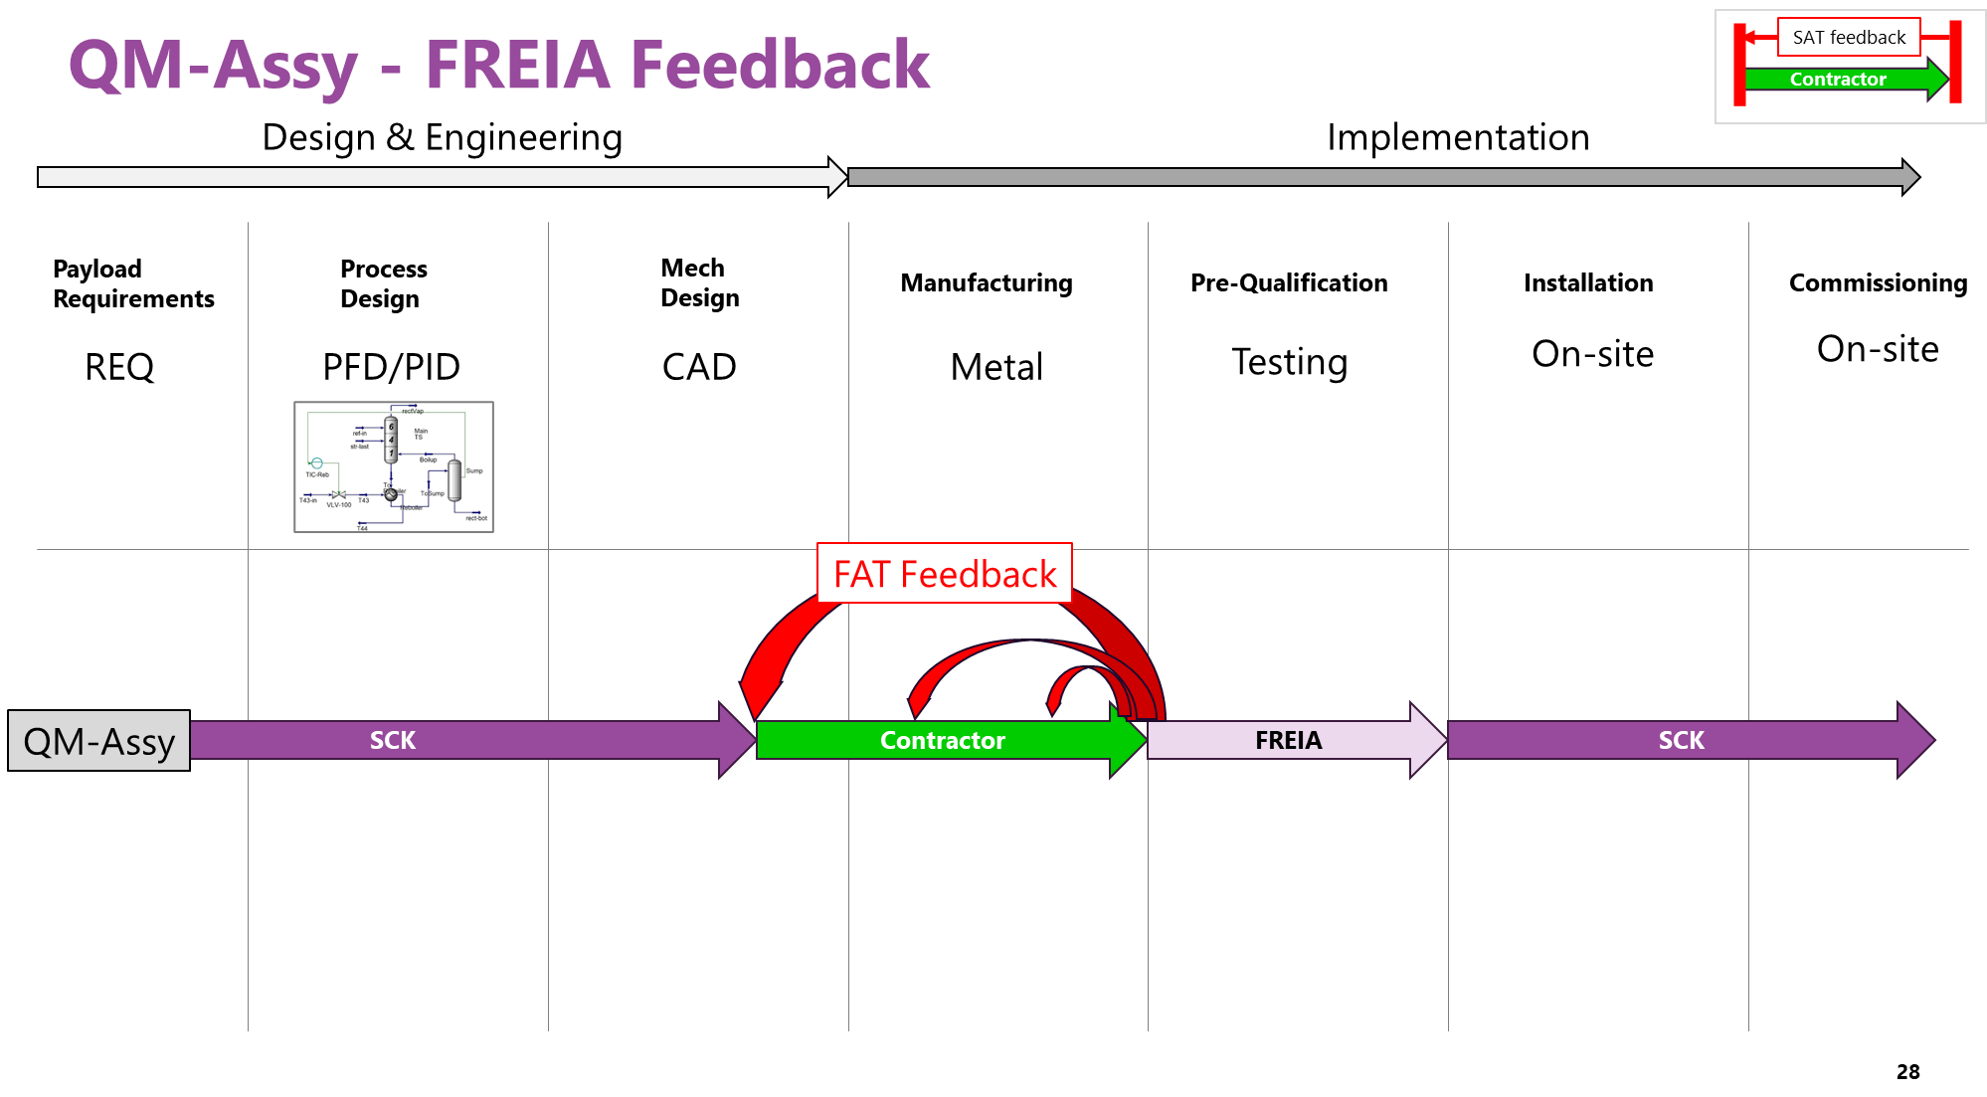
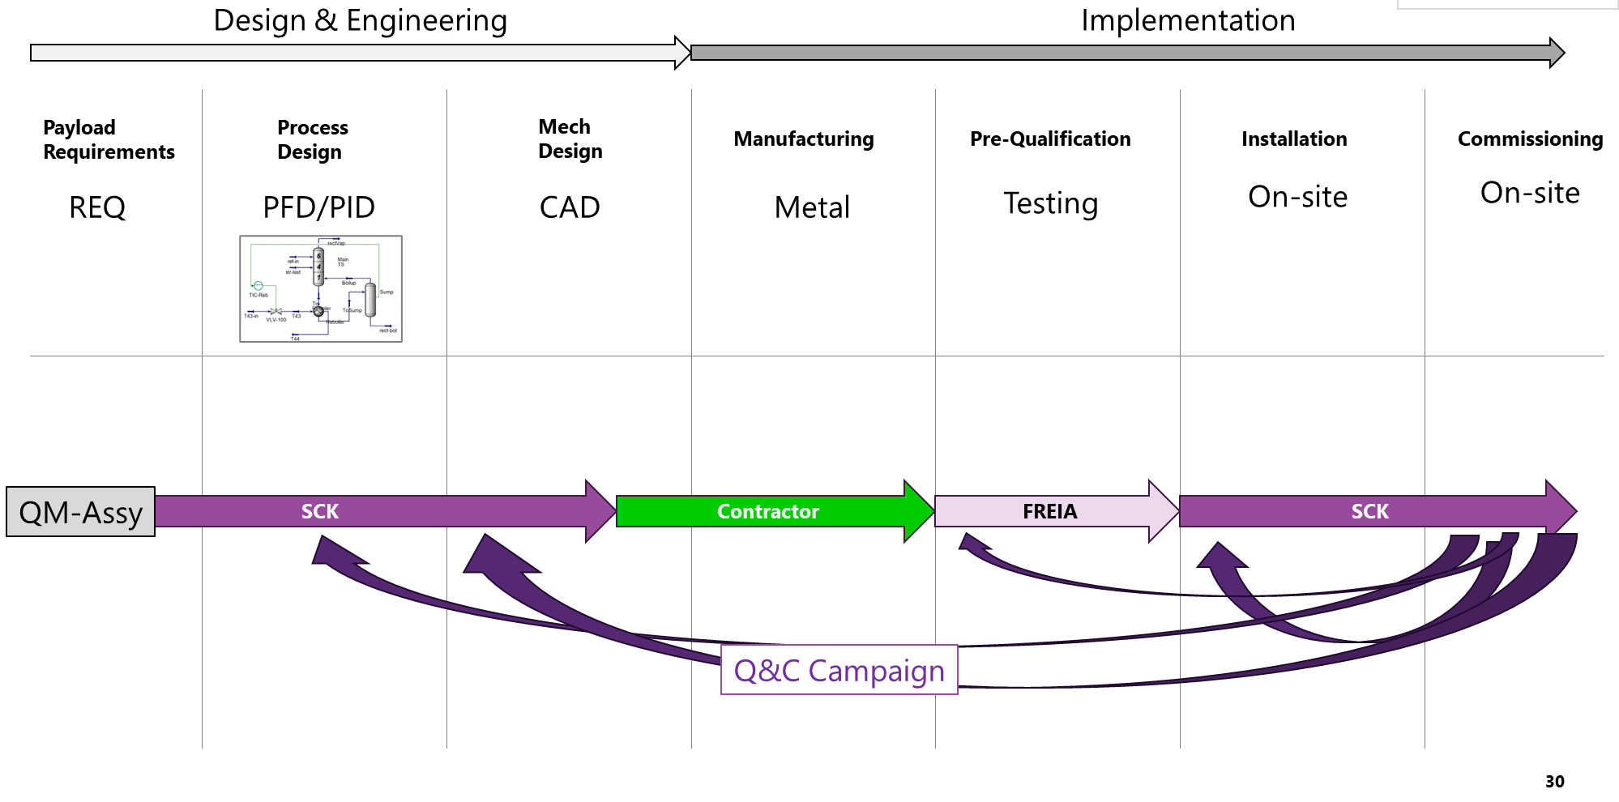
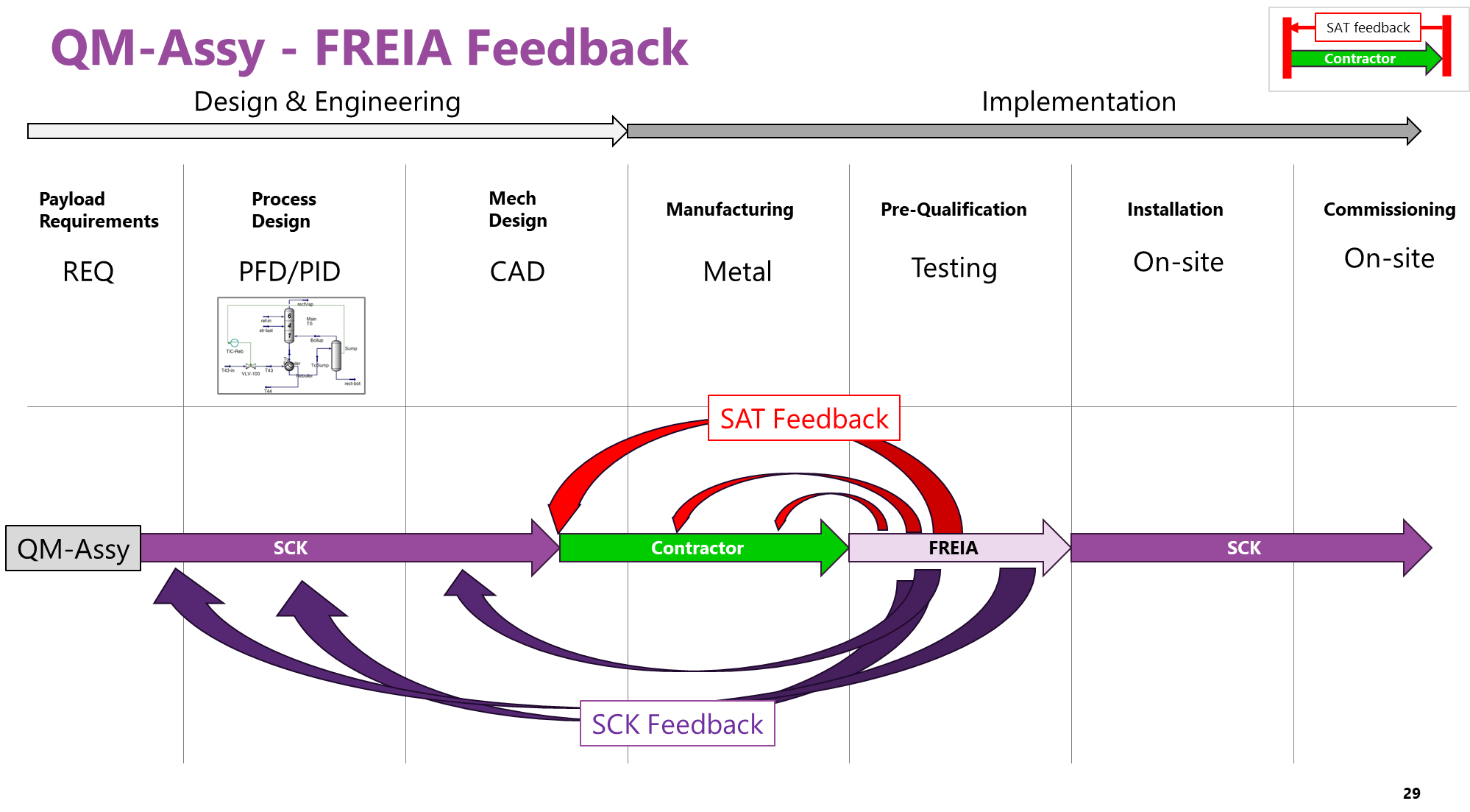
FAT and SAT
FAT & SAT → These are contractual terms
SAT is only for the green and is contractual
FAT/SAT is accepting the activities
SAT is a subset of commissioning campaign
Q&C (Qualification and Commissioning)
This is the general term
Often confused with SAT, but it contains more than just acceptance testing

Slide 6
REX from ESS

Slide 7
2025-03-27 Discussion with Philipp
https://myrrha.atlassian.net/wiki/spaces/ACR/pages/1348960330/2025-03-27+ESS+REX+from+Philipp
To read absolutely

Slide 8
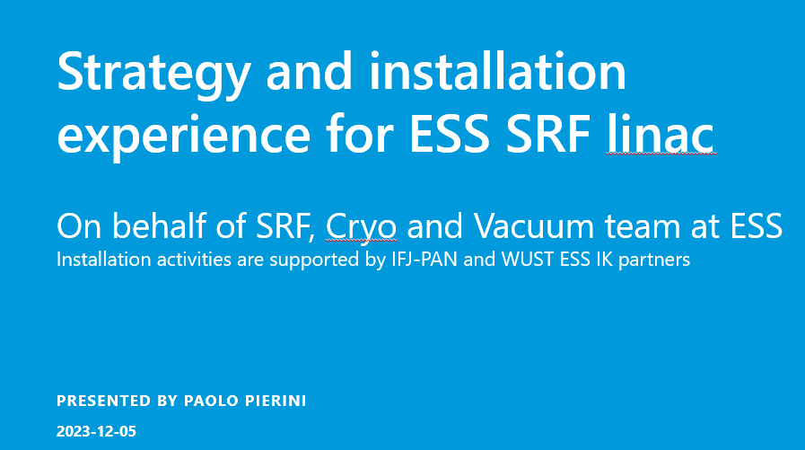
2023-12-50 - Strategy and installation experience for ESS SRF linac.pptx
To read absolutely

Slide 9
ESS book
ESS Book - Chapter 3 Final.pdf https://ecm.sckcen.be/OTCS/llisapi.dll/link/91586851
To read absolutely

Slide 10
Other papers from ESS (Philipp)
Overall Cryo process design:
ESS Cryogenic System Process Design - IOPscience
Recovery, purification: https://iopscience.iop.org/article/10.1088/1757-899X/755/1/012095
Cryoplant controls: ESS Cryogenic Controls Design - EPJ Techniques and Instrumentation
Cryoplant specification: https://www.sciencedirect.com/science/article/pii/S1875389215003971
Safety helium collector for burst disks: https://iopscience.iop.org/article/10.1088/1757-899X/502/1/012132
Safety relief line, helium guard, recovery:
Helium Management of ESS Cryoplants with Common Safety Relief Header and Recovery System - IOPscience
Cryoplant commissioning:
Commissioning of the Large-Scale 2 K Helium Refrigeration System
Also, there are more recent, accepted but not yet published papers on cryo controls for CMs/CDS, commissioning experience with CDS and a whole book on ESS cryogenics edited by John Weisend.

Slide 11
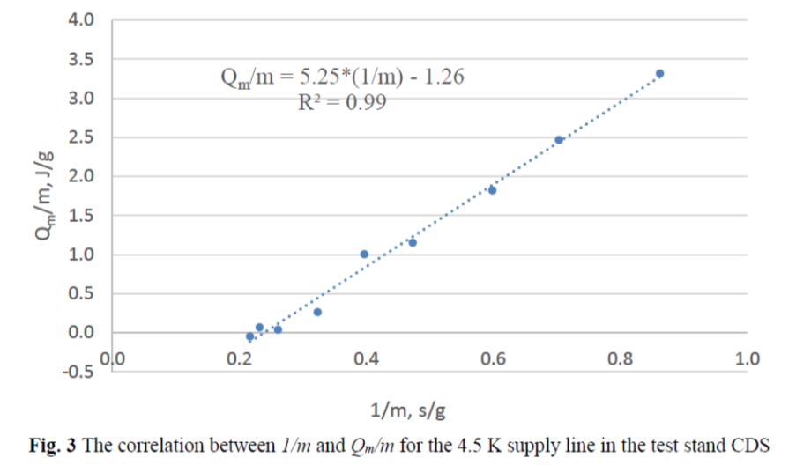
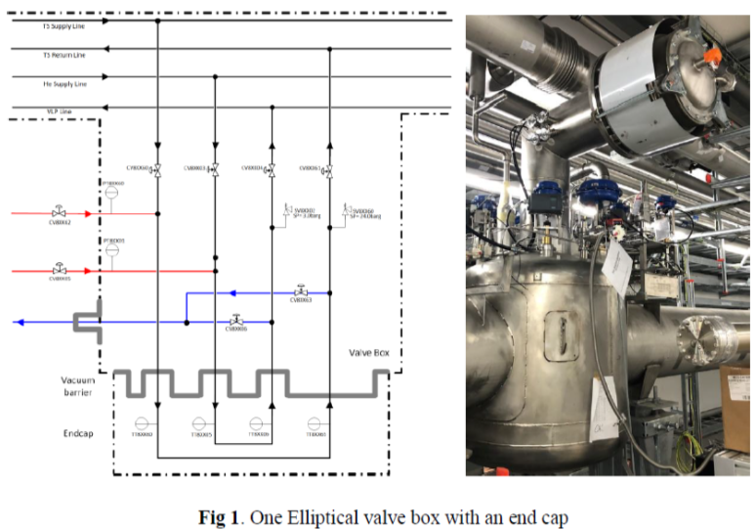
Paper 1
2022 - Zhang - Test preparation of ESS cryoplant and distribution.pdf
This paper describes two different series of test cases developed for the ACCP-CDS assembly, one to be conducted at 8K feed temperature and over-atmospheric pressure to determine the CDS heat load and the other at 2 K equivalent sub-atmospheric conditions with the cold compressors (CCs) in operation to check their performance with the CDS attached.
The new developed control logic, limitations and the interface parameters will be discussed.
they did a cold pre-qualification of their QDB. i mean, cold test before installation

Slide 12
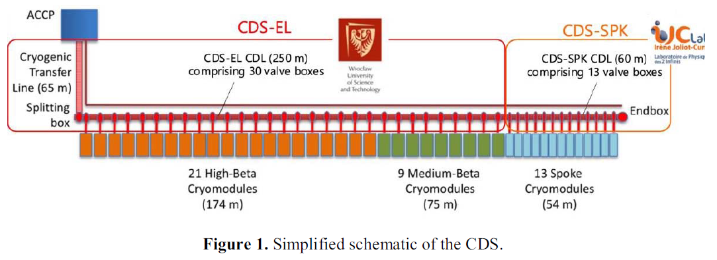
2024 - Commissioning of the cryogenic distribution of the ESS Linac.pdf
2. Commissioning preparation
It is by far easier to conduct most tests and qualify the CDS before the cryomodules (CMs) were, connected. Instead of CMs there were endcaps connected at the valvebox
One type of these tests were measurements of the control valves seat leaks which are quicker and easier if done with a small test volume of the U-tubes instead of a full cryomodule attached. Many leaks were detected predominantly in the elliptical part of the CDS which still need to be completely understood and rectified.
Before that, the pressure transmitters had to be calibrated by first pumping the system down for adjusting the zero and then pressurising for the full operation span
Both, lowest pressure at pumpdown and stability of the high pressure, can be used to get an idea of the overall system leak tightness to air or to the helium recovery system
Verifying the individual curve and wire connection for each of the CERNOX sensors in the CDS. A number of issues were detected as uploading the wrong calibration curve or mixing up, wrongly connected wires or short circuits
Summary (at warm)
Valve leak test (easier with small volumes)
By temperature or pressure ?
Calibration of pressure transmitters
Overall system leak tightness w/o CM
CERNOX calibration curve and cabling check

Slide 13
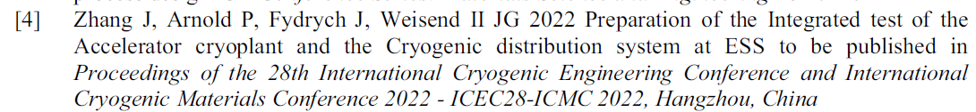
2024 - Commissioning of the cryogenic distribution of the ESS Linac.pdf
The feed at 8K without LHe Dewar and phase separator sub-cooler is a special operations mode that had been developed with the cryoplant supplier Linde Kryotechnik before the testing started so this special mode was needed, why ?
A first inspection after temperature stabilization but before cooldown completion did not reveal severe cold spots or moisture formation on the long cryoline, however some cold spots on valveboxes due to heat conduction.
Even though the detected issues, particularly the valve TAO, were substantial, we proceeded with heat load determination to find out more about the system, it’s capabilities and limitations.
To determine the overall heat load of the CDS without CMs and its liquid helium vessels, we operated the system at 8K, making sure to have one phase and sensible heat to deal with only. Okay, but in normal operation, this is also what we get ..
Also, we wanted to test in a temperature range yielding moderate specific heat capacity gradients and consequently better resolution of the temperature measurements ok so this mode is mainly for better resolution, not because there is no other way since no phase separator ,
Summary (at cold)
Cold spots
TAOs in the Ell VBX
Static heat loads at 8 K

Slide 14
QSYS Q&C Campaigns

Slide 15
QSYS – Q&C, the “reference cold process campaigns”
WHS
WPS
WCS
1. QPLANT alone
QRB
QLM
Cooling power
Cold compressor flow
QVE
QCELL # xx
We plan for the 24x QCELLs for now
Possible to test up to the flow of 30x QCELLs
WHS
WPS
WCS
2. QPLANT + WPS + headers
QRB
QLM
Here the QPLANT has already history, so we don’t start from scratch
Performance was tested, we now have more noise because of the volumes downstream
The QPLANT learns to cope with a user, maybe tweak the gains
QVE
Test Cap
QM not installed yet
QCELL # xx
WHS
WPS
3. QPLANT + WPS + header + branches
WCS
QRB
QLM
QVE
Test Cap
QM not installed yet
QCELL # xx

Slide 16
QSYS – Q&C, the “reference process campaigns”
WHS
WPS
WCS
4. QSYS (QPLANT + QDB + QMs + WPS)
QRB
QLM
xxx
QVE
QCELL # xx

Slide 17
Test list documentation
Those lists shall indicate
What we want to test
When we want (need) to have the test
QM Q test list (ALX 84658439)
Content
The proposed FAT by RI
The list of tests for FREIA
Goal 1: SAT (contract)
Goal 2: feedback for SCK CEN +
QDB and QPLANT Q&C test list (ALX 91139410)
QPLANT Q&C (light summary, just for perspective)
QPLANT Q&C
FAT at vendor premise, SAT

Slide 18
QPLANT + QDB SAT overview
QPLANT commissioning phases
QPLANT Q&C 1.1 = decided for sure
Tests: cooling power, not the efficiency
Threshold on the Cooling power
We make sure the COP is > xxx (rough, don’t pinpoint)
Simulate main: flow 45 g/s on A-B circuits (heater)
TS and coupler loops? Probably not the flow → qualitatively, not quantitative
QRB has dummy cap + heat loads
QRB has all instrumentation needed
What about CIS of the QPLANT ? 1.2 or 2.2 ?
QPLANT C 2.2 (in // to QDB SAT 2.1 ?)
Main loop (A-B): all on QVE → to compare to Q&C 1.1
Need for a 900 W heater set, split in 6x (ACS solution)
Need for 2x valves inlet, 2x valve outlet (ACS solution)
TS loop (D-E): not possible to have 8500 W on QVE only → “dilute” on QVBs
Already 5100 W: 4800 W on QVB passthroughs + 300 W on QVE (passthrough + main TS)
60% for free → enough ?
Coupler loop: not planned
QPLANT C 3.2 (in // to QDB SAT 1.2)
Main loop: same as QPLANT SAT 1.2 → all through QVE
TS loop: additional 4800 W on QVB TS (200 W per TS) → 10100 W in total on TS
Coupler loop: need test cap 2b or +
SAT (QPLANT) all in one contractually
Emulating A-B is fine
Not D-E
Liquefaction load as well (W) TBC
SAT (QDB) = installation and design qualification but not operation (the contractor don’t take the responsibility to operatre
“odd conditions” for QDB testing
A: 3 bar 7 K → OK
B: 1 bar 9 K → OK, not engage the cold CMPs
Emulating D-E and W ?
17 % capacity of QPLANT is from the QDB
Emulating A-B: is it needed for QPLANT Q&C ? Not sure
So, what is needed for QDB Q&C ?

Slide 19
19-03-2025: discussed by DBE & UDO
QPLANT – Q&C
CIS
WHS
QDB/QM is out of scope (may not even be there yet)
Q&C 1.1
Stand-alone
WPS
Contractor internal business
WCS
QPLANT:CS
QRB
Test Cap
Up to Contractor if they want to run this phase in stand-alone
QLM
QVE
QCELL # xx
QPLANT SAT
CIS
WHS
QDB/QM is out of scope (may not even be there yet)
Q&C 1.2
Stand-alone
WPS
For CIS
Only a communication test (query/reply)
I/O
Commands
Data (status, interlocks, …)
Out of scope is debugging of CIS
Contractually, SAT program is done in one big Campaign
Contractor shall prove full Q&C (= Q&C 1.1)
WCS
QPLANT:CS
QRB
Test Cap
QLM
QVE
QCELL # xx
Part of SLA and SPC
Q&C 1.3
Stand-alone
WHS
CIS
QDB/QM is out of scope (may not even be there yet)
WPS
For CIS
Finalize Q&C on its own system.
For QPLANT Contractor
Assist as part of SLA and SPC (Support Contract, hourly rate)
WCS
QPLANT:CS
QRB
Test Cap
QLM
SLA = Service Level Agreement
Contractor ensures system works
Metric is the “uptime” of the system
Flat-rate cost
They solve the issues as needed
QPLANT Tender
It is a Contingent Part (we may or may-not buy it)
SPC = Support Contract
Contractor is available on request
Metric is ad-hoc by SCK
Cost is based on effort (i.e. hourly rate)
They solve the issues when requested
QPLANT Tender
In the offer, the Applicant shall provide details -> fixed part
QVE
QCELL # xx

Slide 20
QDB – Q&C
WHS
QPLANT is out of scope (may not even be there yet)
WPS
Commissioning
Leader: Contractor
Witness: SCK CEN
Operator: Contractor
WCS
QDB
SAT1
2.1 QDB only
QRB
QLM
Needed: QDB only, at warm & w/o process fluids
Part of the QDB Operation Qualification: Valves, Instrumentation, Leaks (INVAC-Air, INVAC-He, He-He)
Not needed yet: QPLANT, QDB:CS, WPS, QMs
Contractor leads and SCK CEN witnesses
QVE
Test Cap Lvl1
QM not installed yet
QCELL # xx
3.2 QPLANT + WPS + header + branches
WHS
WPS
/!\ Warranty of SAT1
Leader: SCK CEN Witness: Contractor
Operator: SCK CEN
QDB
Cold test
WCS
At cold & with process fluids
Needed: QPLANT, QDB:CS, WPS
Helps early identification of “cold issues”, both for all SAT1-components and some of the SAT2-components
SCK CEN runs: SCK CEN experts + operators will actuate the process
Test plan is on SCK CEN responsibility with inputs (limitations) from Contractor.
Contractor: they have to give us the “manual” → the “as-built” specification (so we don’t break the equipment)
Contractor witnesses the commissioning and trains SCK CEN personnel on “firsts”. Need an expert to be present during cold tests and have technicians that can come within a day
QRB
QLM
QVE
Test Ca Lvl2p
QM not installed yet
QCELL # xx
WHS
WPS
QDB
SAT2
4.1. QPLANT + WPS + header + branches
Leader: Contractor
Witness: SCK CEN
Operator: SCK CEN
WCS
QRB
QLM
Here QSYS is fully there
We SAT: QRB & QM welds, PeMos, cold issues of SAT2-componets
Cold issues of “SAT1-components” are scope of warranty
QVE
QCELL # xx

Slide 21
QDB – Q&C Gantt Chart
Installation Phase A (pre-SAT1)
Only Backbone Elements
Only elements that are scope of QDB Tender.
QLM spools
All QVBs
Test caps (!)
QVE
PeMo whenever applicable
No external interfaces. Thus, independent from other QSYS equipment.
Excludes: Chimmney welds, QRB welds
Installation Phase B
QRB-welds
Interfaces to site infrastructure
Plugging cables to patchbox
Installation Phase C
24x QM-Chimey welds
Remaining PeMos
SAT1
Installation
Phases A-B-C
.....
SAT2
Commissioning
QDB Cold Testing Scenario A
QDB Cold Testing Scenario B
QDB Cold Testing
Operated by SCK
Contractor withnesses
Cold-issues:
If on SAT1-component: Contractor fixes as part of warranty
If on SAT2-component: Contractor fixes as preparation towards SAT2

Slide 22
QDB Cold test – details
At cold & with process fluids
Needed: QPLANT, QDB:CS, WPS
Goal
Helps early identification of “cold issues”, both for all SAT1-components and some of the SAT2-components
Qualification: component performance at cold + controls
Major steps
Step 1: headers only
Ste
SCK CEN runs: SCK CEN experts + operators will actuate the process
Test plan is on SCK CEN responsibility with inputs (limitations) from Contractor.
Contractor: they have to give us the “manual” → the “as-built” specification (so we don’t break the equipment)
Contractor witnesses the commissioning and trains SCK CEN personnel on “firsts”. Need an expert to be present during cold tests and have technicians that can come within a day
WHS
WPS
WCS
QRB
QLM
QVE
Test Ca Lvl2p
QM not installed yet
QCELL # xx

Slide 23
2025-03-26 Next move
Get the full REX from ESS → Philipp
Finish the test list on both QPLANT and QDB/QM sides
Try to identify what is needed and when
Approach for the test caps and QVE instrumentation
Can be simple, if we don’t manage to define them fully
Max instrumentation
Can be added later
Same for QVE

Slide 25
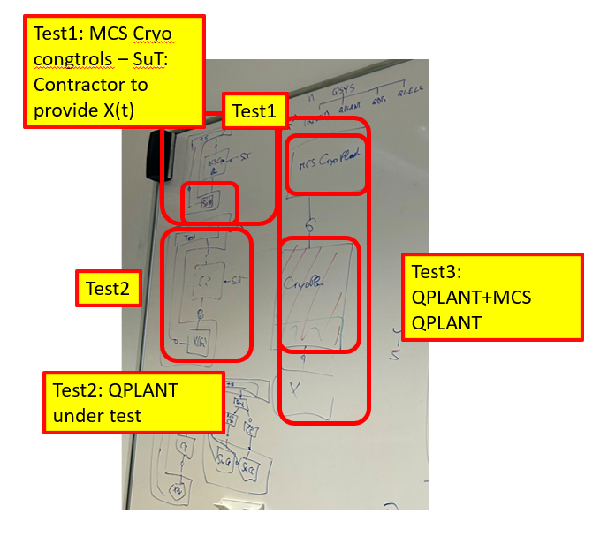
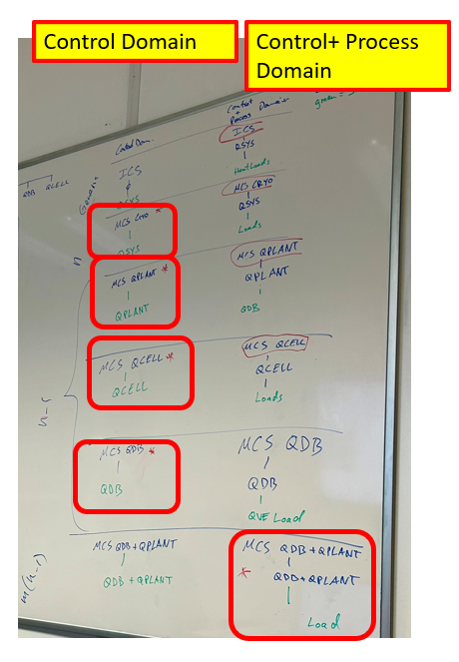
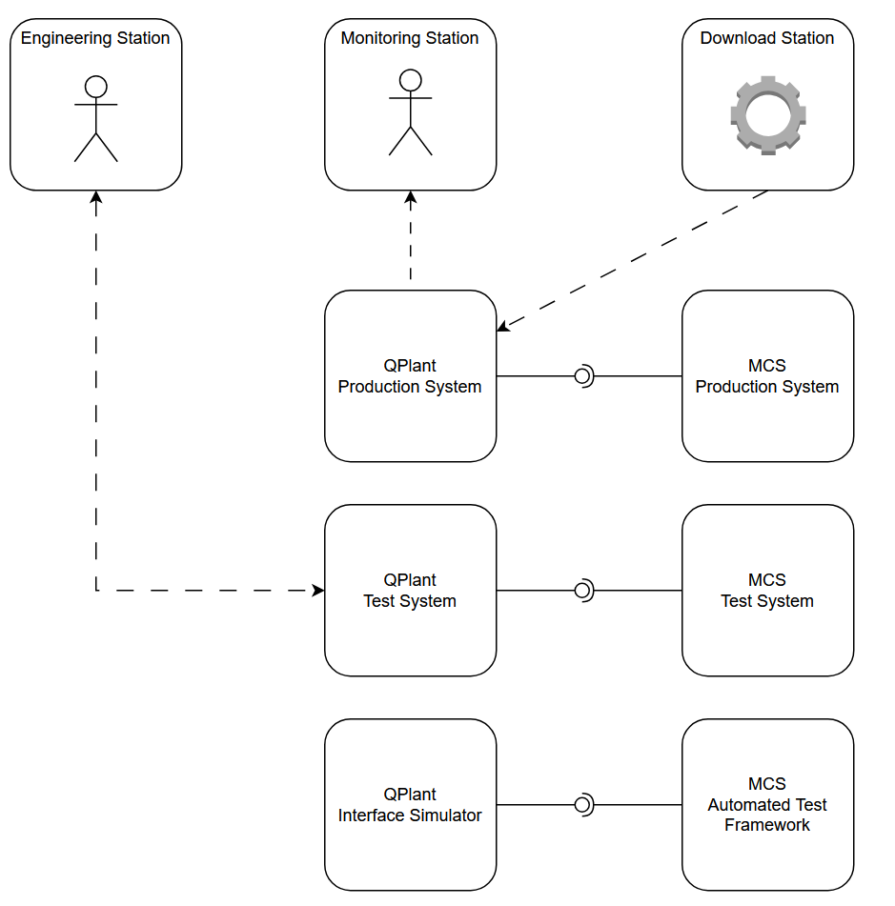
Test system vs simulator
Confluence Minutes 2024-11-27
Type of test. Test System, System Under Test - Output to provide expected representative value
First estimate of possible test - ACR to define more

Slide 26
Test system vs simulator
A System (i.e. QCELL)
.HW
.MH
.PH
.CS
.IS
.SW
.ELEC
.CIRc

Slide 27
Copyright © SCK CEN
All property rights and copyright are reserved.
This presentation contains data, information and formats for dedicated use only and may not be communicated, copied, reproduced, distributed or cited without the explicit written permission of SCK CEN.
If this explicit written permission has been obtained, please reference the author, followed by ‘by courtesy of SCK CEN’.
Any infringement to this rule is illegal and entitles to claim damages from the infringer, without prejudice to any other right in case of granting a patent or registration in the field of intellectual property.
SCK CEN
Belgian Nuclear Research Centre
Studiecentrum voor Kernenergie
Centre d'Etude de l'Energie Nucléaire
Foundation of Public Utility
Stichting van Openbaar Nut
Fondation d'Utilité Publique
Registered Office:
Avenue Herrmann-Debrouxlaan 40 - 1160 BRUSSELS - Belgium
Research Centres:
Boeretang 200 - 2400 MOL - Belgium
Chemin du Cyclotron 6 - 1348 Ottignies-Louvain-la-Neuve - Belgium

Slide 28
QSYS – x
WHS
WPS
S
W
WCS
A
B
D
E
QRB
QLM
QVE
QCELL # xx
WCS
D-E
QLM
QCELL
QVE
A-B
W

